Slide 1


FULL STACK WEB DEVELOPMENT WITH DJANGO
Lecture 29

Slide 2

Today’s Agenda
Developing Our Django App
Building A ContactUs App
Redirecting User To New Page

Slide 3
The ContactUs App
To apply whatever we have learnt in Django Forms till now , we will build a ContactUs App which will display the user a Contact us page .
When the user will fill it , then he will be redirected to a thank you page

Slide 4
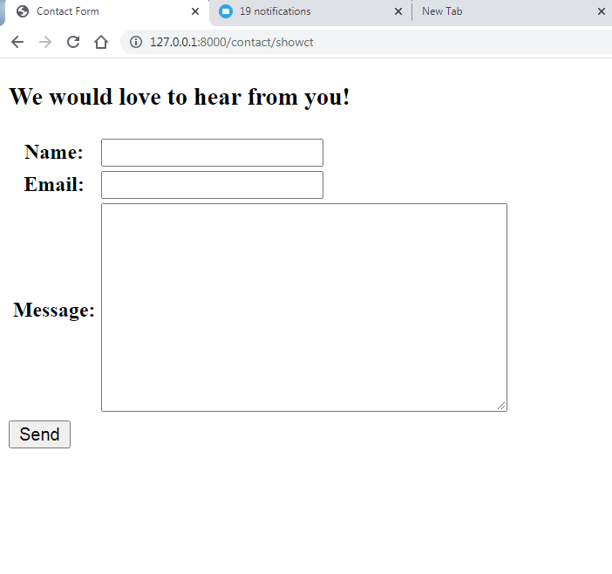
Desired Output

Slide 5
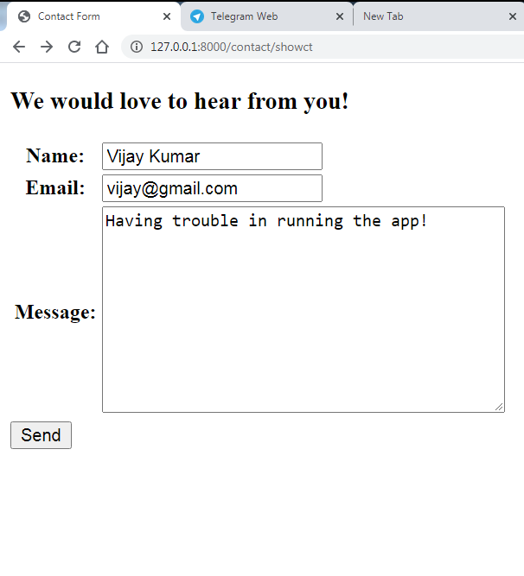
Desired Output

Slide 6
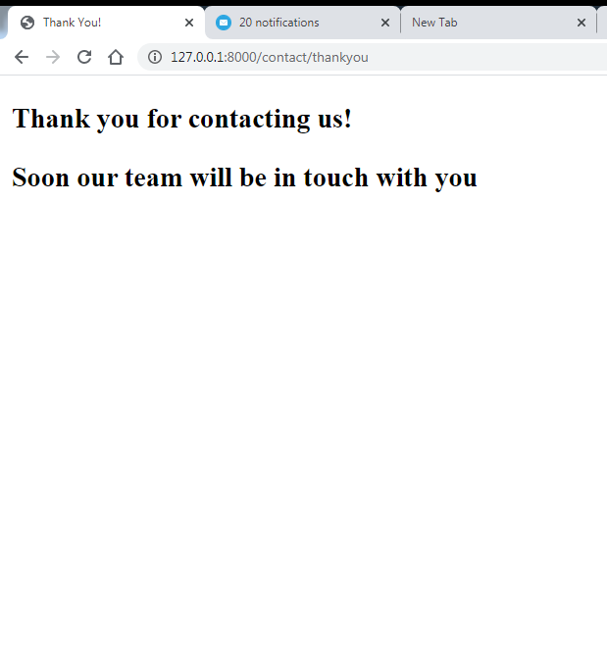
Desired Output

Slide 7
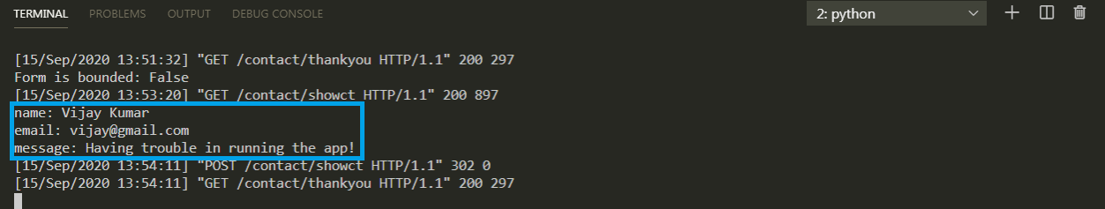
Desired Output

Slide 8
Performing Initial Steps
Load the virtual environment in VS CODE
Create a django project called formdemoproject2 by using the command:
django-admin startproject formdemoproject2
This will create the outer project folder called formdemoproject2 and inner app folder also by the same name

Slide 9
Performing Initial Steps
Now go to the outer project folder formdemoproject2 and create an app called contactusapp by using the command:
django-admin startapp formdemoproject2
Now create a folder called templates in the contactusapp followed by an inner folder called contactusapp

Slide 10
Performing Initial Steps
Inside templates/contactusapp create an HTML files called showcontactform.html
Finally update settings.py so that it contains the name of our app

Slide 11
Performing Initial Steps
Code:
INSTALLED_APPS = [
'django.contrib.admin',
'django.contrib.auth',
'django.contrib.contenttypes',
'django.contrib.sessions',
'django.contrib.messages',
'django.contrib.staticfiles',
‘contactusapp',
]

Slide 12
Creating Form Class
The next step will be to create a file called forms.py in our app folder called contactusapp .
Within the forms.py we will define a class called ContactForm to create the Contact Form

Slide 13
Creating Form Class
from django import forms
class ContactForm(forms.Form):
name = forms.CharField()
email = forms.EmailField()
message=forms.CharField(widget=forms.Textarea)

Slide 14
Connecting Form Object To Views
After creating the Form classes, our next task is to render it in the browser for the user
For this we will have to do the following:
Create a view function called showContactForm( )
Create the Form object in it
Pass this Form object to the template
Render the Form object in the template

Slide 15
The contact( )View Function
from django.shortcuts import render
from contactusapp import forms
def showContactForm(request):
cfrm = forms.ContactForm()
return render(request,'contactusapp/showcontactform.html',
{'form':cfrm})

Slide 16
Creating The showcontactform.html Page
<html>
<head>
<title>Contact us</title>
</head>
<body>
<h1>Contact us</h1>
<h3>We would love to hear from you!</h3>
<form action=“” method=‘POST’>
{% csrf_token %}
<table>
{{ form }}
</table>
<input type='submit' value='Send' >
</form>
</body>
</html>

Slide 17
Configuring URL
Now we need to create a URL conf so Django can find our new view.
To do this follow the below mentioned steps
Create and open the urls.py in the contactusapp1 folder
Add the following URL pattern to this new urls.py:
from django.urls import path
from . import views
urlpatterns = [
path('showct',views.showContactForm)
]

Slide 18
Configuring URL
In the VS Code open the file called urls.py in the demoproject18 folder and update the code in it as shown below:.
Code (demoproject18/urls.py):
from django.contrib import admin
from django.urls import path,include
urlpatterns = [
path('admin/', admin.site.urls),
path(‘contact/',include(‘contactusapp.urls'))
]

Slide 19
Running The App
Now start the server and open the page http://localhost:8000/contatc/showct and this will load the page showcontactform.html with the following output:

Slide 20
Next Step
Now when the user will fill the form and click the submit button , again our view function will run .
But this time we will get a POST request , so we should now improve the view function showContactForm() as follows:
Check whether the request is POST or not. To do this we can use the method attribute of request object whose value is either “POST” or “GET”
If it is not POST then our view function will simply create a ContactForm object and render this form object to the html page contact_form.html
If it is POST request then it means that the user must have submitted the form by pressing submit key.

Slide 21
Next Step
Now the view function will create a ContactForm object with this data check whether the form is valid or not . If it is not valid then it will again render the page showontactform.html sending it the form object ( which contains errors)
If the form is valid then the view function will retrieve all the form data sent by the HTML page , from the ContactForm object by using it’s cleaned_data dictionary and show this data on console.
Then it will redirect to the page thankyou.html which will thank you the user for registering

Slide 22
How To Access Cleaned Data ?
As we know ,Django places all the form data in a dictionary called cleaned_data after performing all the validations.
This dictionary is inside the form object , and has the keys same as the form field names.
So to access this dictionary our syntax will be:
var_name=<form_object>.cleaned_data[‘form_field_name’]
For example:
username=cfrm.cleaned_data[‘name’]

Slide 23
How To Redirect To A New Page ?
Django provides us 2 ways to redirect the user to a new page:
The first is directly calling render() function and passing it the template file to which we want to redirect .
We have been doing this for quite long
The second is to use HttpResponseRedirect class

Slide 24
Using The Class HtpResponseRedirect
HttpResponseRedirect is a subclass of HttpResponse in the Django web framework that returns the HTTP 302 status code, indicating the browser to redirect to a new URL.
This class is most frequently used as a return object from a Django view.
Syntax:
return HttpResponseRedirect(url)

Slide 25
Improved View
from django.shortcuts import render
from contactusapp import forms
from django.http import HttpResponseRedirect
def showContactForm(request):
if request.method == 'POST':
cfrm = forms.ContactForm(request.POST)
if cfrm.is_valid():
name = cfrm.cleaned_data['name']
email = cfrm.cleaned_data['email']
message = cfrm.cleaned_data['message']
print("name:", name)
print("email:", email)
print("message:", message)
return HttpResponseRedirect('/contact/thankyou')
else:
cfrm = forms.ContactForm()
return render(request,'contactusapp/showcontactform.html',{'form':cfrm})
def showThankYouForm(request):
return render(request,'contactusapp/showthankyouform.html')

Slide 26
Creating The showthankyouform.html Page
<html>
<head>
<title>Thank You!</title>
</head>
<body>
<h3>Thank you for contacting us!</h3>
<h3>Soon our team will be in touch with you</h3>
</body>
</body>
</html>

Slide 27
Modified contactusapp/urls.py
from django.urls import path
from . import views
urlpatterns = [
path('showct',views.showContactForm),
path('thankyou',views.showThankYouForm)
]

Slide 28
Running The App
Now start the server and open the page http://localhost:8000/contatc/showct and this will load the page showcontactform.html with the following output:

Slide 29
Running The App

Slide 30
Running The App

Slide 31
Terminal Output

